Slide 1


Capstone Project
Traders
Notes:
Hi everyone,
My name is Shiraj Ahmad,
and I'm a mentor here for data science.
In this session, I'll be explaining Power BI's Capstone Project: Northwind Traders
First, congratulations on completing Excel, SQL, and Power BI.
After completing this Capstone Project, you'll be job-ready!
So, let's get started.

Slide 2
Overview
Customer Analysis
Order Analysis
Employee Analysis
Product Analysis
Supplier Analysis
Shippers Analysis
The Northwind database contains the sales data for a fictitious company called “Northwind Traders,” which imports and exports specialty foods from around the world.
It is an excellent tutorial schema for a small-business ERP, with customers, orders, inventory, purchasing, suppliers, shipping, employees, and single-entry accounting.
Notes:
Overview of Power BI Dashboard for Northwind Traders Dataset:
The Power BI Dashboard for the Northwind Traders dataset offers comprehensive insights into various aspects of the business, focusing on customer analysis, order analysis, employee analysis, product analysis, supplier analysis, and shipper analysis. Leveraging data from these different areas, the dashboard provides a holistic view of Northwind Traders' operations, sales performance, and customer interactions.
Key Components:
1. Customer Analysis:
This section of the dashboard highlights customer-related metrics, including customer demographics, purchasing behavior, and sales performance. Visualizations on customer segments, order history, and customer satisfaction ratings help in identifying high-value customers and understanding their preferences.
2. Order Analysis:
The Order Analysis section provides an overview of order trends, sales revenue, and order fulfillment metrics. Visualizations on order volumes, revenue by region, and delivery times allow for better inventory management and efficient order processing.
3. Employee Analysis:
This section focuses on employee-related data, such as sales performance, employee demographics, and productivity. Visualizations on sales by employee, employee rankings, and performance trends help in recognizing top-performing staff and identifying areas for improvement.
4. Product Analysis:
The Product Analysis section showcases insights into product sales, popularity, and profitability. Visualizations on product sales by category, best-selling products, and gross margin percentages assist in optimizing product offerings and pricing strategies.
5. Supplier Analysis:
This section provides valuable information on suppliers' performance, delivery reliability, and product quality. Visualizations on supplier ratings, on-time deliveries, and product defect rates enable effective supplier management and selection.
6. Shipper Analysis:
The Shipper Analysis section offers insights into shipping efficiency, delivery times, and overall logistics performance. Visualizations on delivery speed, shipping costs, and customer satisfaction with delivery services aid in streamlining shipping operations.
Benefits:
1. Data-Driven Decision Making:
The Power BI Dashboard empowers business stakeholders to make informed decisions based on data-driven insights. This leads to better strategic planning and resource allocation.
2. Customer-Centric Approach:
Analyzing customer data allows Northwind Traders to understand customer preferences and behavior, enabling the delivery of personalized services and targeted marketing campaigns.
3. Sales Optimization:
Insights from the dashboard aid in optimizing sales strategies, identifying high-performing products, and focusing on profitable customer segments.
4. Supply Chain Efficiency:
Analyzing supplier and shipper data facilitates improved supplier management and logistics optimization, resulting in streamlined supply chain operations.
5. Employee Performance Enhancement:
Evaluating employee performance data enables recognition of top performers and the implementation of training programs to enhance overall team productivity.
In conclusion, the Power BI Dashboard for the Northwind Traders dataset provides valuable insights into customer analysis, order analysis, employee analysis, product analysis, supplier analysis, and shipper analysis. By leveraging these insights, Northwind Traders can optimize their operations, enhance customer satisfaction, and make data-backed decisions to drive business growth and success.

Slide 3

Problem Statement
Objective
Analysis Scope
Goal
Insights & Recommendations.
Report & Presentation
Notes:
Problem Statement for Power BI Report on Northwind Traders Database:
Objectives:
Create a visually appealing Power BI report that communicates key performance metrics effectively.
Generate insights into customer behavior, sales patterns, and employee performance to aid decision-making processes.
Identify areas for improvement, such as optimizing inventory management and enhancing customer satisfaction.
Enable stakeholders to interact with the data, allowing for ad-hoc analysis and data exploration.
Scope: The Power BI report will encompass various aspects of the Northwind Traders business, including sales analysis, customer segmentation, inventory trends, and employee performance. It will consolidate data from multiple tables to provide a comprehensive view of the company's operations.
Develop an intuitive and user-friendly Power BI report that caters to the needs of different stakeholders, from management to sales teams.
Highlight key insights derived from the data, enabling stakeholders to make data-driven decisions.
Facilitate data exploration through interactive visualizations and drill-down capabilities.
Approach:
Extract data from the Northwind Traders database and perform necessary data cleansing and transformation.
Design visually engaging charts, graphs, and tables to represent critical business metrics.
Implement dynamic filters and slicers to enable users to focus on specific aspects of the data.
Utilize Power BI's interactive features to allow users to interact with the report and explore data in real-time.
Develop a well-structured report layout that presents information logically and coherently.
Expected Impact: The implementation of the Power BI report will revolutionize the way Northwind Traders interacts with its data. By offering valuable insights into sales trends, customer behavior, and inventory management, the report will empower stakeholders to make well-informed decisions. Additionally, the report's interactive nature will facilitate data exploration, leading to a deeper understanding of the business and opportunities for growth and optimization.
Ultimately, the Power BI report will serve as a powerful tool in Northwind Traders' quest to remain competitive and drive its business forward in the dynamic wholesale market landscape.

Slide 4


Significance
Valuable insights
Improvement focus
Evaluation of effectiveness
Trend identification
Comprehensive understanding
Notes:
The significance of the Northwind Traders database for a Power BI report lies in its value as a representative and practical dataset, which can be leveraged to create insightful and meaningful reports. Here are some key points highlighting the significance of using the Northwind Traders database for a Power BI report:
The Northwind Traders database simulates a real-world business environment, allowing users to work with data that closely resembles actual business operations. This enables them to develop relevant reports and gain hands-on experience in analyzing business data.
The database contains various tables representing different entities, such as customers, products, orders, suppliers, and employees. Power BI users can explore the relationships between these entities, create engaging visualizations, and gain a comprehensive understanding of how different aspects of the business interconnect.
The Northwind Traders database covers a wide range of business scenarios, including sales analysis, customer segmentation, inventory management, and supplier performance evaluation. This provides ample opportunities for Power BI users to create diverse and insightful reports catering to different business needs.
With the database's rich data content, Power BI users can experiment with various visualization techniques to represent the data visually. Creating interactive and visually appealing reports enables stakeholders to grasp insights quickly and make informed decisions.
In summary, the Northwind Traders database's significance for a Power BI report lies in its practicality, versatility, and value as a learning tool. It offers a well-structured and relatable dataset for Power BI users to gain valuable experience in data analysis, reporting, and visualization within a simulated business context.

Slide 5
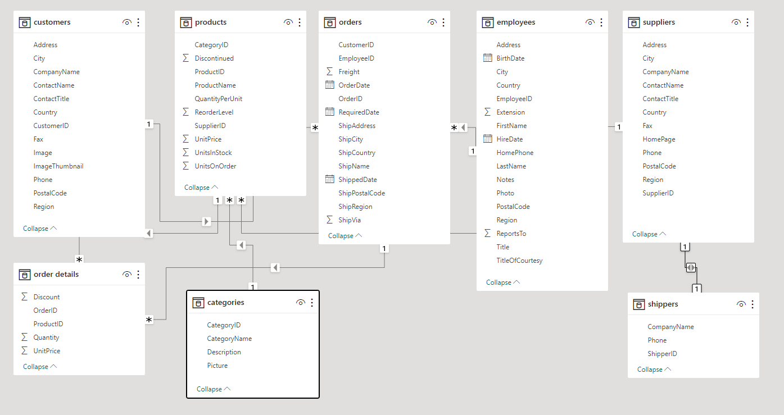
ER Diagram
Notes:
Now that we have comprehended the problem statement and recognized the significance of the project, let's delve into a thorough understanding of the dataset.
The Entity-Relationship (ER) diagram for the sample Northwind Traders database visually represents the relationships and interactions between various entities (tables) in the database. Here's an explanation of the ER diagram based on the provided tables:
Customers: Represents individual customers of Northwind Traders. Each customer is identified by a unique customer ID and contains attributes such as customer name, contact information, and address.
Employees: Represents the employees working for Northwind Traders. Each employee is identified by a unique employee ID and contains attributes like employee name, job title, and contact details.
Products: Stores information about the products offered by Northwind Traders. Each product is identified by a unique product ID and contains attributes such as product name, unit price, and quantity in stock.
Orders: Represents customer orders placed with Northwind Traders. Each order is identified by a unique order ID and contains attributes like order date, customer ID (foreign key), and employee ID (foreign key) responsible for processing the order.
Suppliers: Represents the suppliers from whom Northwind Traders purchases products. Each supplier is identified by a unique supplier ID and contains attributes like company name, contact information, and address.
Categories: Stores different product categories to which products belong. Each category is identified by a unique category ID and contains attributes like category name and description.
Shippers: Represents shipping companies responsible for delivering orders. Each shipper is identified by a unique shipper ID and contains attributes like company name and contact information.
I trust that you now have a clear understanding of the Capstone project requirements.

